Slide 1
演算法概論
蔡錫鈞
助教:
官霆軒
Notes:
Algorithm在電腦計算中扮演什麼樣的角色

Slide 2
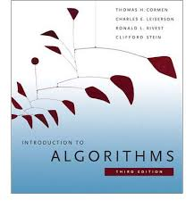
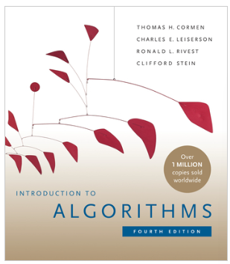
先修課程:
程式設計，資料結構，離散數學
課本:
Cormen, Leiserson, Rivest and Stein, ``Introduction to Algorithms‘’, 3rd ed, 2009 or 4th ed, 2022, MIT press.
Notes:
排序(Sorting)是一個相當重要且基本的問題

Slide 3
作業考試及評量:
手寫作業 ，程式作業 20% 每週1-2兩題程式題目，考試週除外
期中考 25%
期末考 30%
一至兩次上機考 25%
程式上傳系統: https://nycu-oj.cs.nycu.edu.tw/
Moodle: https://e3p.nctu.edu.tw
Notes:
排序(Sorting)是一個相當重要且基本的問題

Slide 4
授課內容:
Introduction
Getting Started
Growth of Functions
Recurrence
More on Divide and Conquer
FFT
Heapsort + segment tree
Quicksort
Sorting in linear time
Median Selection
Hash Tables, Bloom Filter
Dynamic Programming
Greedy Algorithms
Amortized Analysis
B-trees, Red-Black Tree
Fibonacci Heaps
Disjoint Set Operations
Elementary Graph algorithms
Minimum Spanning Tree
Single Source Shortest Path
All Pairs Shortest Paths
Maximum flow related topics
Linear Programming (Optional)
Number-Theoretic Algorithms
NP-complete, Approximation algorithms
Notes:
排序(Sorting)是一個相當重要且基本的問題

Slide 5
Some Facts:
Some already know programming in high school
At least 1/3 of the CS major cannot program effectively
10-15% of the class may withdraw or fail this course
Need >= 6 hours course work weekly to avoid it
Start programming assignment early
Plagiarism (抄襲) is a serious violation
You may discuss with human or GPT but write your own version!
AI is very good at writing and programming!
Notes:
排序(Sorting)是一個相當重要且基本的問題

Slide 6
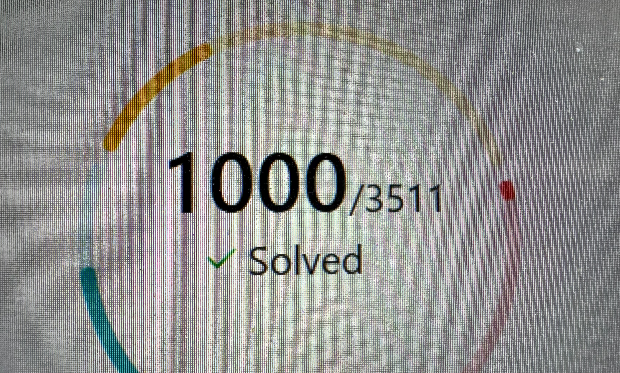
Some Open Sources: 練習題目來源
LeetCode: 線上程式練習競賽平台，每週日都有線上比賽。每日提供一題練習題，適合練習
Codeforces: https://codeforces.com
Code Jam: Google 舉辦
ICPC world final, and regional contests
IOI: 資訊奧林匹亞
NCPC: 教育部大專程式競賽
…………
Notes:
排序(Sorting)是一個相當重要且基本的問題

